Slide 1
Spiritual Development in Seaver College Students
Alumni Leadership Council
September 18, 2013
Don Thompson
Cindy Miller-Perrin
Notes:
This template can be used as a starter file for presenting training materials in a group setting.
Sections
Sections can help to organize your slides or facilitate collaboration between multiple authors. On the Home tab under Slides, click Section, and then click Add Section.
Notes
Use the Notes pane for delivery notes or to provide additional details for the audience. You can see these notes in Presenter View during your presentation.
Keep in mind the font size (important for accessibility, visibility, videotaping, and online production)
Coordinated colors
Pay particular attention to the graphs, charts, and text boxes.
Consider that attendees will print in black and white or grayscale. Run a test print to make sure your colors work when printed in pure black and white and grayscale.
Graphics, tables, and graphs
Keep it simple: If possible, use consistent, non-distracting styles and colors.
Label all graphs and tables.

Slide 2
Literature Review Highlights
Spirituality in Higher Education, UCLA
      Cultivating the Spirit – Astin, Astin, & Lindholm
Christian Smith, Notre Dame
      Moralistic Therapeutic Deism
Tim Clydesdale, Lilly Endowment Scholar
  Benefits of Vocation School Initiatives
    Retention
    Life Discernment & Resilience to Adversity
    Students Seek Mentorship
    Spiritual Maturity Increases

Slide 3
Research Findings
Students experience significant changes in their spiritual development during their sophomore year, when they frequently go through formative crises with regard to their faith, identity, and sense of vocational calling or life purpose.

Slide 4
The Sophomore Experience:
College as Rite of Passage
    Departure, Initiation, Return
Research Hypothesis & Measures
    Student vocational development is formed by the intersection of faith development, identity development, and spiritual barriers.
Longitudinal Design
    Three consecutive 4-year cohorts
    300 item survey, sampled annually
    4000 undergraduate student participants

Slide 5
Ego Identity Status Measure
5
  Diffusion: no exploration or commitment
    “I haven’t really considered politics. It just doesn’t excite me much.”
  Foreclosure: no exploration, but commitment
    “My parents decided a long time ago what I should go into for employment and I’m following through with their plans.”
  Moratorium: exploration without commitment
    “Religion is confusing to me right now. I keep changing my views on what is right and wrong for me.”
  Achievement: exploration and commitment
    “It took me a while to figure it out, but now I really know what I want for a career.”

Slide 6
Changes in Identity Development
(Explore, Commit)
6
Notes:
6

Slide 7
Faith Attitude Survey
7
Subscales | Sample Items
Strength of Beliefs (α = 0.73) | I view myself as a religious person. I have doubts about whether my religious beliefs are true.
Importance of Faith (α = 0.89) | Religion is not a very important part of my life right now. My faith is not very important to me.
Life Application of Faith (α = 0.92) | I depend on my faith in God for decision-making and direction. I try hard to carry my religious beliefs into all other dealings in my life.

Slide 8
Changes in Faith Development
8
Notes:
8

Slide 9
Vocational Discernment and Action
9
Subscales | Sample Items
Discernment and Purpose (α = .76) | I have a good sense for my life purpose. I know of the many ways that I can use my gifts and talents within the context of my professional career. I am unsure about what God is specifically calling me to do.
Service to Others (α = .68) | I am motivated to choose a career that will enable me to provide some type of service to others. I feel a deep sense of responsibility for reducing pain and suffering in the world.

Slide 10
Changes in Vocational
Discernment & Action
10

Slide 11
Key Intervention – Sophomore Year
International Program Experience

Slide 12
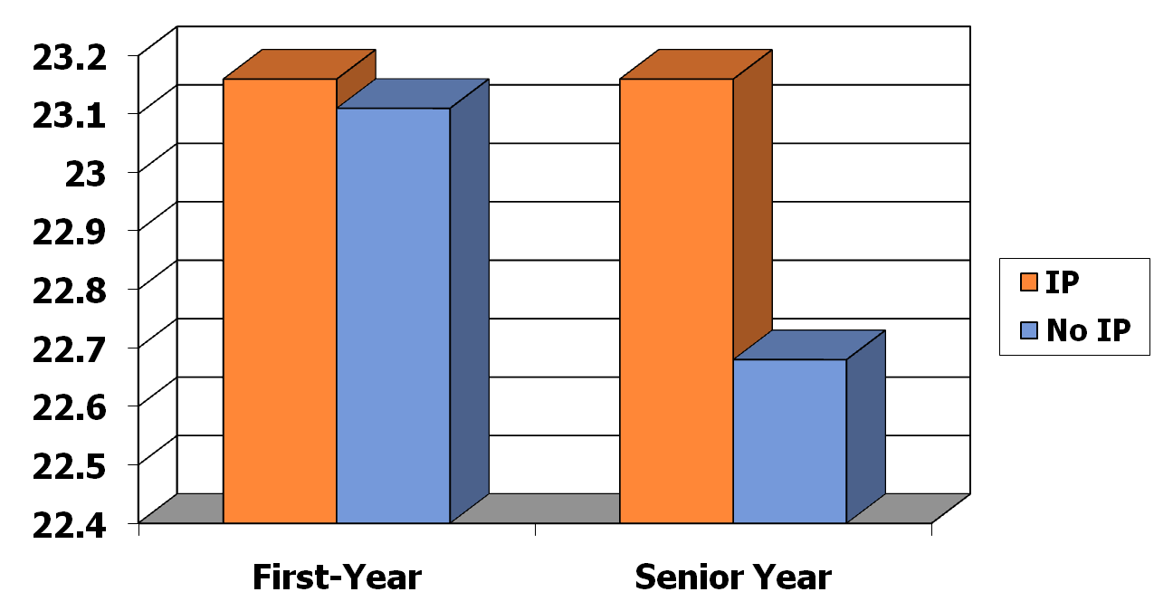
Strength of Belief Scores
First-Year and Senior Time Periods
12

Slide 13
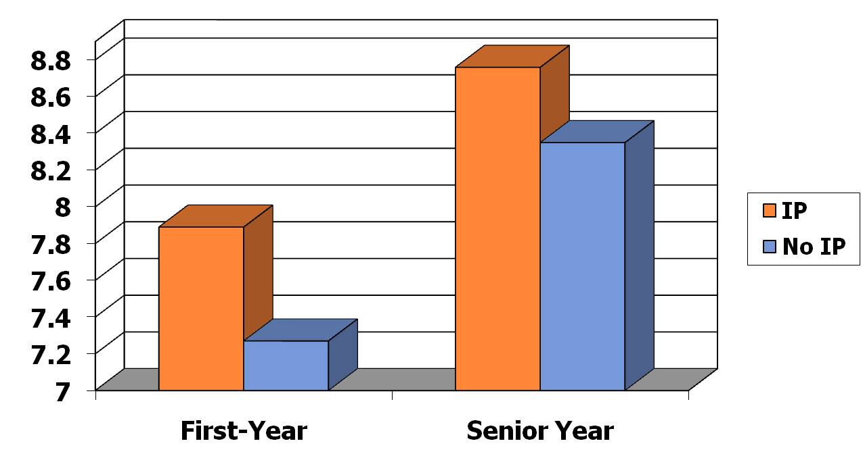
Faith Importance Scores
First-Year and Senior Time Periods
13

Slide 14
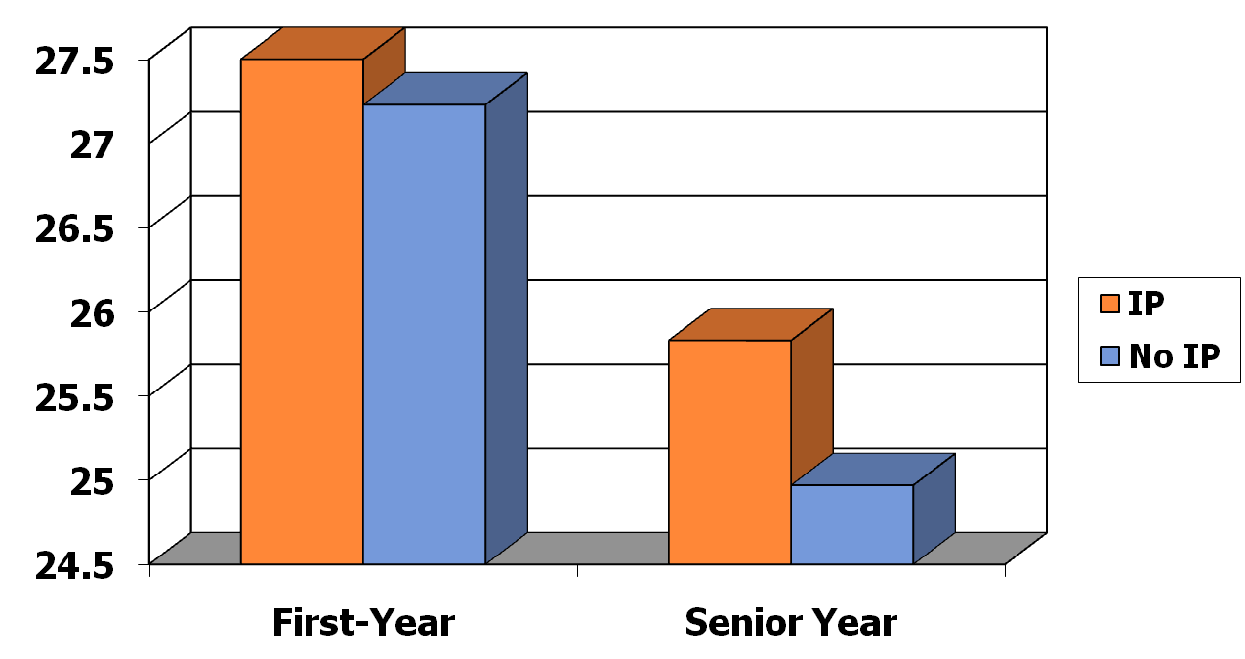
Faith Behavior Scores
First-Year and Senior Time Periods
14

Slide 15
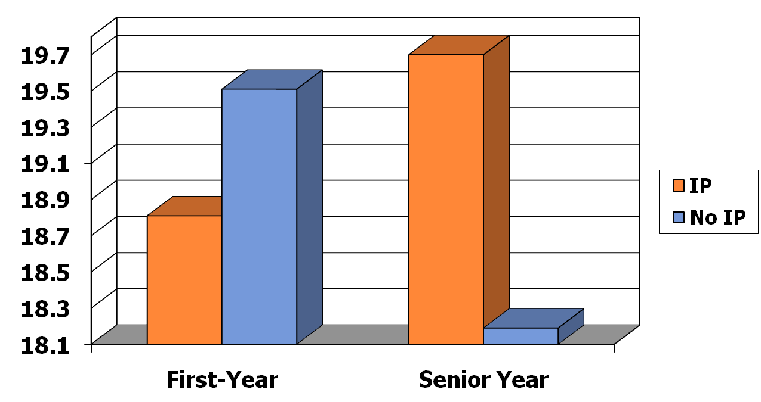
Faith Application Scores
First-Year and Senior Time Periods
15

Slide 16
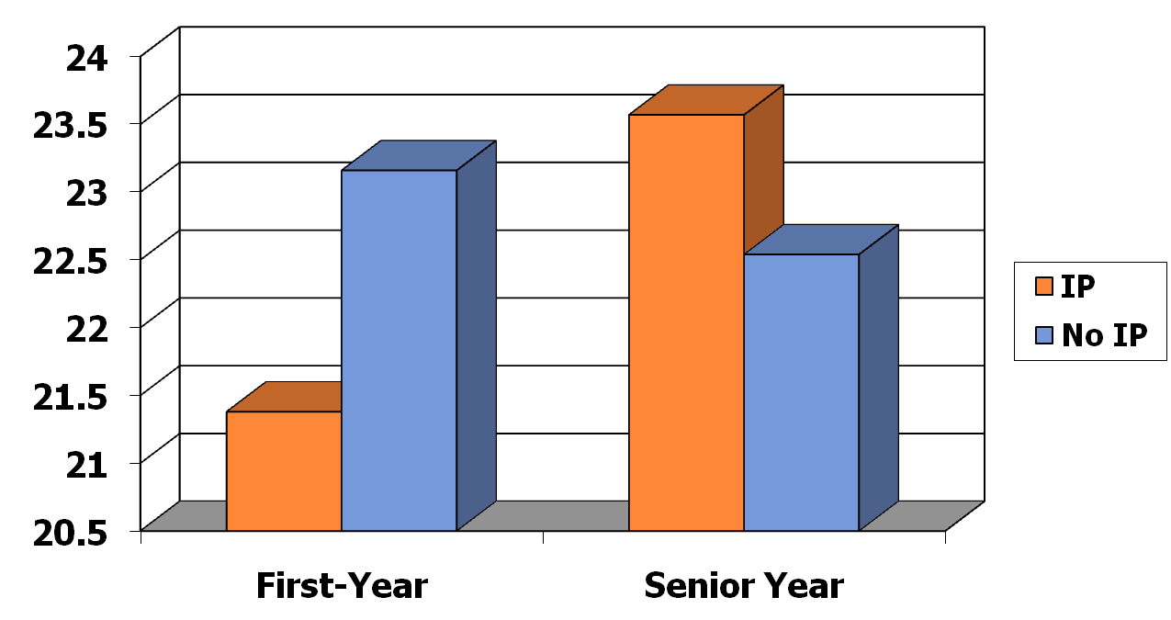
Discernment Scores
First-Year and Senior Time Periods
16

Slide 17
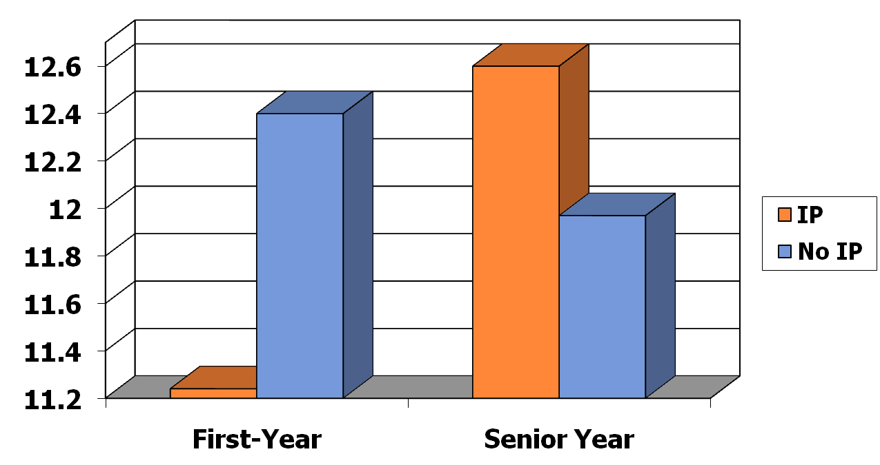
Service Scores
First-Year and Senior Time Periods
17

Slide 18
Factors Contributing to Spiritual Growth in International Programs
18
Travel
  Departure & Initiation
Mentoring
  Initiation
Community
  Initiation & Return

Slide 19
Travel
What has been the most spiritually challenging part of your International Program experience?
19
This has been the hardest but also the best year of my life. Living overseas forced me to either embrace or reject what I have believed all my life. It removed my safety nets.
I have grown through having to lean on God in almost every situation: from traveling to school to just living in a different culture, speaking another language.
My month long trip to Africa between semesters challenged my sense of self.
Traveling alone over Christmas Vacation showed me how to depend on the grace of God for support.
A person I met in Greece helped me realize my selfishness, making me want to be more generous.

Slide 20
Mentoring
Who has been most instrumental in helping you grow spiritually? Why?
20
One of the other students in the program made me challenge myself and helped me grow spiritually.
The host family impacted me the most because we are in worship with them and they are the leaders that we look up to in the house.
When I felt weak, my faculty “mom” knew and was someone that would come up to me and ask what was wrong. She would help me understand and trust in God.
The host family made me feel at home and always made time to check on me and how I was doing.
The program assistant had a great impact on me spiritually this semester through her incredible yet humble display of faith. She is such an inspirational woman of God.

Slide 21
Community
How has the community of the international program experience enhanced your spiritual growth?
21
Our weekly, student led Bible studies & student run worship have had the greatest spiritual impact on me.
Women's small group and student-led worship were an AMAZING support system. The best community I've ever had. This is my home away from home.
The guys’ small group was a time where we could be open and honest.
I have grown more here in my spirituality than I did at home and all of that growth was due to other students.
Simply by living with and engaging with such incredible individuals, who have not only helped me through difficult times, but who have encouraged me to seek God more, I've experienced a growth in spirituality.

Slide 22
Conclusions & Recommendations
Sophomores Experience Dramatic Spiritual Change
International living and learning experiences facilitate greater growth in faith, sense of life purpose, and identity
Significant opportunities for personal growth occur when students leave their cultural comfort zone and rely on communities with mentoring support
Spiritual Challenge is unavoidable and desirable
Faculty/Staff Preparation & Community
Mentor-Protégé Relationship – Key to Initiation and Return
Use the Vocation/Life-Purpose Lens to Deepen Faith Development
Connect with Alumni & Their Faith Development

Slide 23
Alumni Project Goals
2013-2018
Connect with Alumni Groups across the country in their home areas.
Partner with the work of the Alumni Leadership Council, strengthening their work and energizing alumni around the country.
Help alumni reflect on their life journey and the impact of their Pepperdine experience, thereby allowing them to reconnect with their alma mater and its mission.

Slide 24
Research
Gather feedback via focus groups from 30-35 year old alumni on their development of faith, identity, and life purpose since leaving Pepperdine University. Areas to examine include barriers to living out their life purpose and faith development as well as critical mentoring relationships and peak experiences that they have had over the last 10-15 years.
Collect alumni recommendations on how the Pepperdine University experience can more greatly enhance preparation for life after college in terms of faith and life purpose pursuit. Ideas from alumni will be shared with the Alumni Leadership Council, the five school deans, Provost Tippens, and President Benton.
Invite participants to submit short autobiographical essays online, describing their life purpose journey, following focus group discussions on this topic. With their permission, we then hope to compile these reflective writings and publish them for broader dissemination.

Slide 25
Method
We wish to convene groups of 12-15 alumni in various regional settings (Seattle, San Francisco, Los Angeles, Atlanta, Arizona, Dallas, Chicago, Miami, etc.) by gathering for dinner and discussion at major hotels in these regional hubs.
Event Preparation and Format
Prior to each event, we plan to send out a brief survey to alumni in each region in order to gather preliminary data and provide them with a context and invitation to meet with us. We will then gather in these city centers to discuss their experiences and provide them with some background on our research findings.

Slide 26
Schedule
Fall 2013
Plan and contact first alumni groups in preparation for both Spring and Summer 2014.
Phase 1
Fall 2013-Spring 2018: Hold Three Events per year (Fall, Spring, Summer) in order to convene events in major alumni hubs across the nation and annually report our findings to these groups, alumni at large, and the senior administration. This phase will allow us to work with 15 alumni chapters.
Phase 2
Fall 2018-Spring 2023: Pending the success of Phase I, we propose continuing to meet with three groups each year, allowing us to complete our connection with the existing 30 alumni chapters.

Slide 27
Don Thompson thompson@pepperdine.edu
310.506.4831
Cindy Miller-Perrin cperrin@pepperdine.edu
310.506.4027

